Slide 1
Machine Learning
Ever since computers were invented, we have wondered whether they might be made to learn.
If we could understand how to program them to learn-to improve automatically with experience-the impact would be dramatic.
Imagine computers learning from medical records which treatments are most effective for new diseases
Houses learning from experience to optimize energy costs based on the particular usage patterns of their occupants
Personal software assistants learning the evolving interests of their users in order to highlight especially relevant stories from the online morning newspaper.
A successful understanding of how to make computers learn would open up many new uses of computers and new levels of competence and customization.
‹#›
Notes:
‹#›

Slide 2
Examples
For problems such as speech recognition, algorithms based on machine learning outperform all other approaches that have been attempted to date.
In data mining field, machine learning algorithms are being used routinely to discover valuable knowledge from large commercial databases containing equipment maintenance records, loan applications, financial transactions, medical records, and the like.
‹#›

Slide 3
Applications using ML
Learning to recognize spoken words.
All of the most successful speech recognition systems employ machine learning in some form. For example, the SPHINX system learns speaker-specific strategies for recognizing the primitive sounds (phonemes) and words from the observed speech signal.
Neural network learning methods and methods for learning hidden Markov models are effective for automatically customizing to, individual speakers, vocabularies, microphone characteristics, background noise, etc.
‹#›

Slide 4
Learning to drive an autonomous vehicle.
Machine learning methods have been used to train computer-controlled vehicles to steer correctly when driving on a variety of road types.
For example, the ALVINN system has used its learned strategies to drive unassisted at 70 miles per hour for 90 miles on public highways among other cars.
Learning to classify new astronomical structures.
For example, decision tree learning algorithms have been used by NASA to learn how to classify celestial objects from the second Palomar Observatory Sky Survey.
This system is now used to automatically classify all objects in the Sky Survey, which consists of three terabytes of image data.
‹#›

Slide 5
Learning to play world-class backgammon.
The most successful computer programs for playing games such as backgammon are based on machine learning algorithms. For example, the world's top computer program for backgammon, TD-GAMMON learned its strategy by playing over one million practice games against itself.
It now plays at a level competitive with the human world champion.
Similar techniques have applications in many practical problems where very large search spaces must be examined efficiently.
‹#›

Slide 6
WELL-POSED LEARNING PROBLEMS
Definition: A computer program is said to learn from experience E with respect to some class of tasks T and performance measure P, if its performance at tasks in T, as measured by P, improves with experience E.
For example, a computer program that learns to play checkers might improve its performance as measured by its abiliry to win at the class of tasks involving playing checkers games, through experience obtained by playing games against itself.
In general, to have a well-defined learning problem, we must identity these three features: the class of tasks, the measure of performance to be improved, and the source of experience.
‹#›

Slide 7
A checkers learning problem:
Task T: playing checkers
Performance measure P: percent of games won against opponents
Training experience E: playing practice games against itself
A handwriting recognition learning problem:
Task T: recognizing and classifying handwritten words within images
Performance measure P: percent of words correctly classified
Training experience E: a database of handwritten words with given classifications
‹#›

Slide 8
A robot driving learning problem:
Task T: driving on public four-lane highways using vision sensors
Performance measure P: average distance traveled before an error (as judged by human overseer)
Training experience E: a sequence of images and steering commands recorded while observing a human driver
‹#›

Slide 9
DESIGNING A LEARNING SYSTEM
let us consider designing a program to learn to play checkers, with the goal of entering it in the world checkers tournament.
We adopt the obvious performance measure: the percent of games it wins in this world tournament.
Choosing the Training Experience:
The first design choice we face is to choose the type of training experience from which our system will learn.
The type of training experience available can have a significant impact on success or failure of the learner.
One key attribute is whether the training experience provides direct or indirect feedback regarding the choices made by the performance system.
‹#›

Slide 10
For example, in learning to play checkers, the system might learn from direct training examples consisting of individual checkers board states and the correct move for each.
Alternatively, it might have available only indirect information consisting of the move sequences and final outcomes of various games played.
In this later case, information about the correctness of specific moves early in the game must be inferred indirectly from the fact that the game was eventually won or lost.
Here the learner faces an additional problem of credit assignment, or determining the degree to which each move in the sequence deserves credit or blame for the final outcome.
‹#›

Slide 11
Credit assignment can be a particularly difficult problem because the game can be lost even when early moves are optimal, if these are followed later by poor moves.
Hence, learning from direct training feedback is typically easier than learning from indirect feedback.
A second important attribute of the training experience is the degree to which the learner controls the sequence of training examples.
For example, the learner might rely on the teacher to select informative board states and to provide the correct move for each.
Alternatively, the learner might itself propose board states that it finds particularly confusing and ask the teacher for the correct move.
‹#›

Slide 12
The learner may have complete control over both the board states and (indirect) training classifications, as it does when it learns by playing against itself with no teacher present.
consider a number of settings for learning, including settings in which training experience is provided by a random process outside the learner's control,
settings in which the learner may pose various types of queries to an expert teacher,
and settings in which the learner collects training examples by autonomously exploring its environment.
A third important attribute of the training experience is how well it represents the distribution of examples over which the final system performance P must be measured.
‹#›

Slide 13
In general, learning is most reliable when the training examples follow a distribution similar to that of future test examples.
In our checkers learning scenario, the performance metric P is the percent of games the system wins in the world tournament.
If its training experience E consists only of games played against itself, there is an obvious danger that this training experience might not be fully representative of the distribution of situations over which it will later be tested.
Crucial assumption that the distribution of training examples is identical to the distribution of test examples.
‹#›

Slide 14
let us decide that our system will train by playing games against itself. This has the advantage that no external trainer need be present, and it therefore allows the system to generate as much training data as time permits.
We now have a fully specified learning task
A checkers learning problem:
Task T: playing checkers
Performance measure P: percent of games won in the world tournament
Training experience E: games played against itself
In order to complete the design of the learning system, we must now choose
the exact type of knowledge to be learned
a representation for this target knowledge
a learning mechanism
‹#›

Slide 15
Choosing the Target Function
Given this setting where we must learn to choose among the legal moves, the most obvious choice for the type of information to be learned is a program, or function, that chooses the best move for any given board state.
Let us call this function ChooseMove and use the notation ChooseMove : B -> M to indicate that this function accepts as input any board from the set of legal board states B and produces as output some move from the set of legal moves M.
Throughout our discussion of machine learning we will find it useful to reduce the problem of improving performance P at task T to the problem of learning some particular target function such as ChooseMove.
‹#›

Slide 16
The choice of the target function will therefore be a key design choice.
Although ChooseMove is an obvious choice for the target function in our example, this function will turn out to be very difficult to learn given the kind of indirect training experience available to our system.
An alternative target function and one that will turn out to be easier to learn in this setting is an evaluation function that assigns a numerical score to any given board state.
Let us call this target function V and again use the notation V : B ->R to denote that V maps any legal board state from the set B to some real value (we use R to denote the set of real numbers).
We intend for this target function V to assign higher scores to better board states.
‹#›

Slide 17
Let us therefore define the target value V(b) for an arbitrary board state b in B, as follows:
1. if b is a final board state that is won, then V(b) = 100
2. if b is a final board state that is lost, then V(b) = -100
3. if b is a final board state that is drawn, then V(b) = 0
4. if b is a not a final state in the game, then V(b) = V(b '), where b' is the best final board state that can be achieved starting from b and playing optimally until the end of the game (assuming the opponent plays optimally, as well).
The goal of learning in this case is to discover an operational description of V ; that is, a description that can be used by the checkers-playing program to evaluate states and select moves within realistic time bounds.
‹#›

Slide 18
Thus, we have reduced the learning task in this case to the problem of discovering an operational description of the ideal target function V.
It may be very difficult in general to learn such an operational form of V perfectly.
In fact, we often expect learning algorithms to acquire only some approximation to the target function, and for this reason the process of learning the target function is often called function approximation.
In the current discussion we will use the symbol V’ to refer to the function that is actually learned by our program, to distinguish it from the ideal target function V.
‹#›

Slide 19
Choosing a Representation for the Target Function
we have specified the ideal target function V, we must choose a representation that the learning program will use to describe the function V’ that it will learn.
we again have many options.
We could, for example, allow the program to represent using a large table with a distinct entry specifying the value for each distinct board state.
Or we could allow it to represent using a collection of rules that match against features of the board state,
or a quadratic polynomial function of predefined board features, or an artificial neural network.
To keep the discussion brief, let us choose a simple representation: for any given board state, the function V’ will be calculated as a linear combination of the following board features:
‹#›

Slide 20
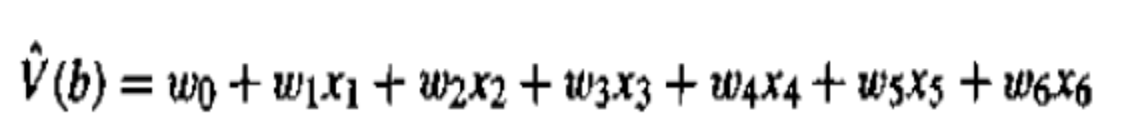
xl: the number of black pieces on the board
x2: the number of red pieces on the board
x3: the number of black kings on the board
x4: the number of red kings on the board
x5: the number of black pieces threatened by red (i.e., which can be captured on red's next turn)
x6: the number of red pieces threatened by black
Thus, our learning program will represent V’(b) as a linear function of the form
where w0 through w6 are numerical coefficients, or weights, to be chosen by the learning algorithm.
Learned values for the weights w l through w6 will determine the relative importance of the various board features in determining the value of the board, whereas the weight wo will provide an additive constant to the board value.
‹#›

Slide 21
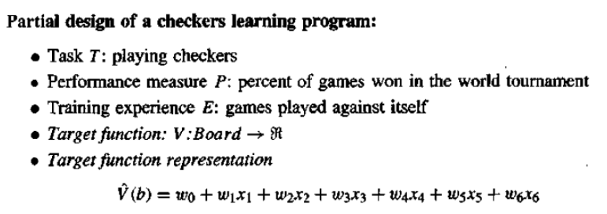
The first three items above correspond to the specification of the learning task, whereas the final two items constitute design choices for the implementation of the learning program.
Notice the net effect of this set of design choices is to reduce the problem of learning a checkers strategy to the problem of learning values for the coefficients wo through w6 in the target function representation.
‹#›

Slide 22
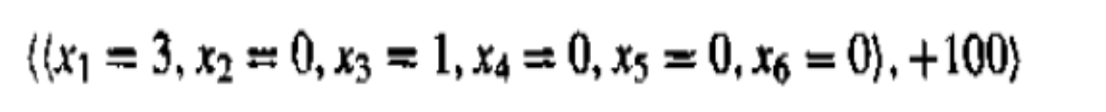
Choosing a Function Approximation Algorithm
To learn the target function V’ we require a set of training examples, each describing a specific board state b and the training value Vtrain(b) for b.
In other words, each training example is an ordered pair of the form (b, V'(b)).
For instance, the following training example describes a board state b in which black has won the game (note x2 = 0 indicates that red has no remaining pieces) and for which the target function value Vtrain(b) is therefore +100.
‹#›

Slide 23
ESTIMATING TRAINING VALUES
The only training information available to our learner is whether the game was eventually won or lost.
On the other hand, we require training examples that assign specific scores to specific board states.
While it is easy to assign a value to board states that correspond to the end of the game, it is less obvious how to assign training values to the more numerous intermediate board states that occur before the game's end.
Of course the fact that the game was eventually won or lost does not necessarily indicate that every board state along the game path was necessarily good or bad.
‹#›

Slide 24

For example, even if the program loses the game, it may still be the case that board states occurring early in the game should be rated very highly and that the cause of the loss was a subsequent poor move.
This approach is to assign the training value of Vtrain(b) for any intermediate board state b to be V’succ(b) where V’ is the learner's current approximation to V and where Successor(b) denotes the next board state following b for which it is again the program's turn to move (i.e., the board state following the program's move and the opponent's response)
‹#›

Slide 25

ADJUSTING THE WEIGHTS
All that remains is to specify the learning algorithm for choosing the weights wi to best fit the set of training examples { (b,V train(b)).
As a first step we must define what we mean by the bestfit to the training data.
One common approach is to define the best hypothesis, or set of weights, as that which minimizes the square error E between the training values and the values predicted by the hypothesis V.
we seek the weights that minimize E for the observed training examples.
‹#›

Slide 26
Several algorithms are known for finding weights of a linear function that minimize E defined in this way.
we require an algorithm that will incrementally refine the weights as new training examples become available and that will be robust to errors in these estimated training values.
One such algorithm is called the least mean squares, or LMS training rule.
For each observed training example it adjusts the weights a small amount in the direction that reduces the error on this training example.
This algorithm can be viewed as performing a stochastic gradient-descent search through the space of possible hypotheses (weight values) to minimize the squared error E.
‹#›

Slide 27
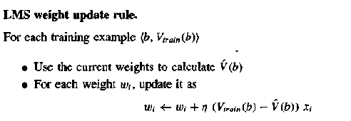
Here η is a small constant (e.g., 0.1) that moderates the size of the weight update.
To get an intuitive understanding for why this weight update rule works, notice that when the error (Vtrain(b)- c(b)) is zero, no weights are changed.
When (Vtrain(b) – V’(b)) is positive (i.e., when v’(b) is too low), then each weight is increased in proportion to the value of its corresponding feature.
This will raise the value of V’(b), reducing the error.
‹#›

Slide 28
Notice that if the value of some feature xi is zero, then its weight is not altered regardless of the error, so that the only weights updated are those whose features actually occur on the training example board.
Surprisingly, in certain settings this simple weight-tuning method can be proven to converge to the least squared error approximation to the Vtrain values
‹#›

Slide 29
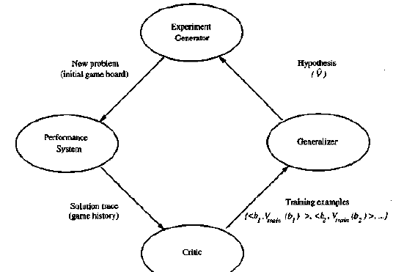
The Final Design
‹#›

Slide 30
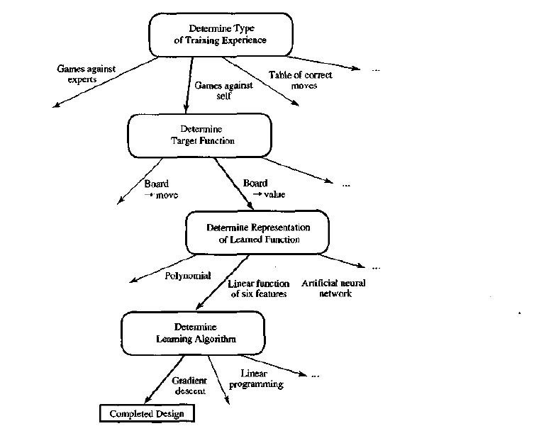
Summary of choices in designing the checkers learning program
‹#›

Slide 31
Would the program we have designed be able to learn well enough to beat the human checkers world champion?
Probably not. this is because the linear function representation for V’ is too simple representation to capture well the critics of the game.
However, given a more sophisticated representation for the target function, this general approach can, in fact, be quite successful.
For example, Tesauro (1992, 1995) reports a similar design for a program that learns to play the game of backgammon, by learning a very similar evaluation function over states of the game.
‹#›

Slide 32
His program represents the learned evaluation function using an artificial neural network that considers the complete description of the board state rather than a subset of board features.
After training on over one million self-generated training games, his program was able to play very competitively with top-ranked human backgammon players.
‹#›

Slide 33
PERSPECTIVES AND ISSUES IN MACHINE LEARNING
One useful perspective on machine learning is that it involves searching a very large space of possible hypotheses to determine one that best fits the observed data and any prior knowledge held by the learner.
For example, consider the space of hypotheses that could in principle be output by the above checkers learner.
This hypothesis space consists of all evaluation functions that can be represented by some choice of values for the weights wo through w6.
The learner's task is thus to search through this vast space to locate the hypothesis that is most consistent with the available training examples.
‹#›

Slide 34
The LMS algorithm for fitting weights achieves this goal by iteratively tuning the weights, adding a correction to each weight each time the hypothesized evaluation function predicts a value that differs from the training value.
This algorithm works well when the hypothesis representation considered by the learner defines a continuously parameterized space of potential hypotheses.
Many algorithms that search a hypothesis space defined by some underlying representation (e.g., linear functions, logical descriptions, decision trees, artificial neural networks).
These different hypothesis representations are appropriate for learning different kinds of target functions.
‹#›

Slide 35
For each of these hypothesis representations, the corresponding learning algorithm takes advantage of a different underlying structure to organize the search through the hypothesis space.
Issues:
What algorithms exist for learning general target functions from specific training examples?
In what settings will particular algorithms converge to the desired function, given sufficient training data?
Which algorithms perform best for which types of problems and representations?
How much training data is sufficient?
What general bounds can be found to relate the confidence in learned hypotheses to the amount of training experience and the character of the learner's hypothesis space?
‹#›

Slide 36
When and how can prior knowledge held by the learner guide the process of generalizing from examples?
Can prior knowledge be helpful even when it is only approximately correct?
What is the best strategy for choosing a useful next training experience, and how does the choice of this strategy alter the complexity of the learning problem?
What is the best way to reduce the learning task to one or more function approximation problems?
Put another way, what specific functions should the system attempt to learn?
Can this process itself be automated?
How can the learner automatically alter its representation to improve its ability to represent and learn the target function?
‹#›

